Slide 1
Intermediate-Code Generation
CSE 430
Instructor
Dr. Shamim H. Ripon
http://www.ewubd.edu/~dshr

Slide 2
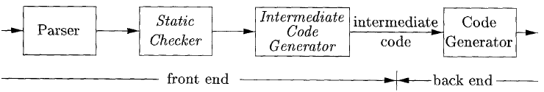
In the analysis-synthesis of a compiler
Front end analyzes the source program and creates an intermediate code
Back end generates the target code

Slide 3
Variant of Syntax Tree
Syntax tree
Node represents language constructs of source
Children node represent components of constructs
A DAG(directed acyclic graph) for expression
Identifies common subexpression – that occur more than once.
Can be constructed using same techniques as syntax tree.

Slide 4
Construction of DAG
Leaves for atomic operands
Interior nodes for operators
A node can have more than one parent if the node is a common subexpression
DAG provides clues to code generator to produce efficient code

Slide 5
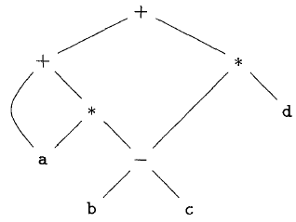
Example
a + a * (b – c) + (b – c) * d

Slide 6
DAG vs Syntax Tree
A syntax tree or a DAG can be created from same SDD.
In a DAG,
Before creating a node, it is checked whether an identical node already exists

Slide 7
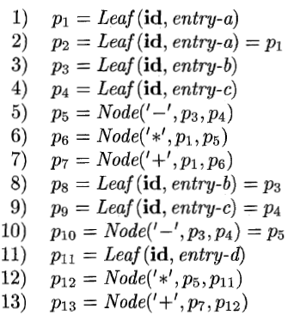
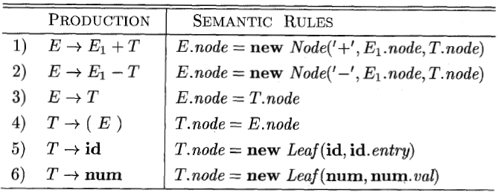
Steps to create the DAG in slide 5

Slide 8
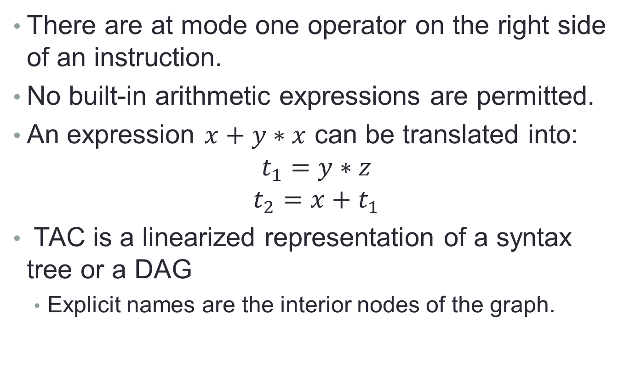
Three Address Code (TAC)
There are at mode one operator on the right side of an instruction.
No built-in arithmetic expressions are permitted.
An expression $x+y∗x$ can be translated into:
$$t_{1}=y∗z$$
$$t_{2}=x+t_{1}$$
TAC is a linearized representation of a syntax tree or a DAG
Explicit names are the interior nodes of the graph.

Slide 9
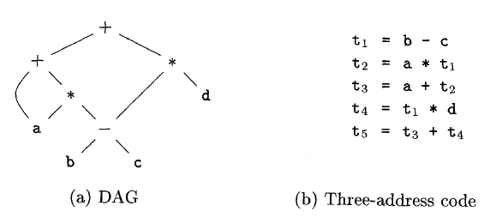
Example (TAC)

Slide 10
Types and Declaration
Type checking
Use logical rules to check the behaviour of a program
Ensures that the type of the operands match the expected type of the operator.
Translation Application
Compiler can determine the required storage needed for a typed name
Calculate the address of array reference

Slide 11
Type Expression
Type expression
Representation of type structure
Can be
basic type or
Formed by applying type constructor

Slide 12
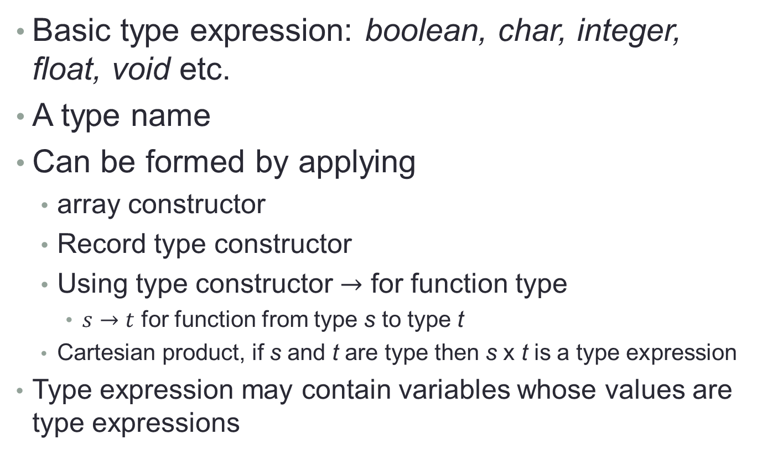
Type expression definition
Basic type expression: boolean, char, integer, float, void etc.
A type name
Can be formed by applying
array constructor
Record type constructor
Using type constructor $→$ for function type
$s→t$ for function from type s to type t
Cartesian product, if s and t are type then s x t is a type expression
Type expression may contain variables whose values are type expressions

Slide 13
Type Checking
Problem: Verify that a type of a construct matches that expected by its context.
Examples:
mod requires integer operands (PASCAL)
* (dereferencing) – applied to a pointer
a[i] – indexing applied to an array
f(a1, a2, …, an) – function applied to correct arguments.
Information gathered by a type checker:
Needed during code generation.

Slide 14
Type Systems
A collection of rules for assigning type expressions to the various parts of a program.
Based on: Syntactic constructs, notion of a type.
Example: If both operators of “+”, “-”, “*” are of type integer then so is the result.
Type Checker: An implementation of a type system.
Syntax Directed.
Sound Type System: eliminates the need for checking type errors during run time.

Slide 15
Type Checking
Compiler assigns type expression to the component of source program.
Check that these type expression confirms the typing system of the source language
Type checking can catch potential errors in program.
Can be used to improve the security of systems to allow software modules to be imported an executed.

Slide 16
Type Checking Rules
Two forms of type checking
Type Synthesis
the type of an expression is built on the types of its subexpressions
Names are to be declared before their use
Type inference
Determines the type of a language construct from its use.
It is required for languages like ML(Meta language)

Slide 17
Equivalence of Type Expressions
Problem: When in E1.type = E2.type?
We need a precise definition for type equivalence
Interaction between type equivalence and type representation
Example: type vector = array [1..10] of real
type weight = array [1..10] of real
var x, y: vector; z: weight
Name Equivalence: When they have the same name.
x, y have the same type; z has a different type.
Structural Equivalence: When they have the same structure.
x, y, z have the same type.

Slide 18
Type Conversion
Conversion rules varies between languages
Java follows two conversions ( example in next slide)
Widening:
intended to preserve information
Lower type in the hierarchy can be widened to higher type
Narrowing:
can loose information
A type s can be converted to type t if there is a path from s to t
Implicit conversion: automatically done by compiler, also called coercion
Explicit conversion: manually done by programmer, also called casts.

Slide 19
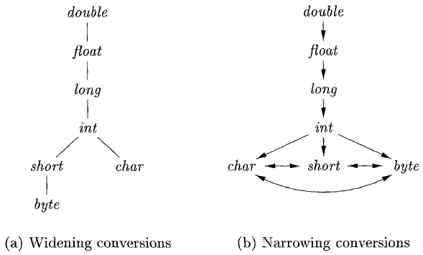
Additional reading topics from text book:
Overloading of functions and operators
Type inference and polymorphic functions
Substitution, Inference and Unification

